Slide 1
Problem Statement
Title: Develop a 2D Occupancy Grid Map of a Room using Overhead Cameras.
This project addresses the need for autonomous mobile robots (AMRs) to navigate indoor environments with precision and adaptability. By developing a detailed 2D occupancy grid map using overhead cameras, similar to those employed by AMRs with ROS2-based SLAM algorithms.
The aim is to provide these robots with a clear understanding of their surroundings. This map not only identifies static obstacles like chairs, tables, and boxes but also dynamically updates to accommodate changes in the environment, such as the movement of furniture items.

Slide 2
Unique Idea Brief (Solution)
Our goal is environment Mapping for AMR Navigation.
Focus on map merging using occupancy grids for robotics applications.
Mapping and navigating unstructured environments with accuracy and efficiency.
Instead of traditional feature-based mapping, leveraging occupancy grids for robust environment modeling.
Introducing a novel use of metric ψ (inspired by Birk) to measure similarity between occupancy grid maps.
Improved accuracy in mapping and navigation in complex, dynamic environments.
Enables real-time map updates and adjustments based on new sensory data.
Applicable across various industries requiring autonomous navigation, from logistics to search and rescue.
Our project introduces a pioneering method for map merging using occupancy grids, advancing the capabilities of robotic systems in navigating and understanding their surroundings.

Slide 3
Features Offered
Map the entire environment in one shot.
Map moving obstacles in real-time.
Reduce AMR costs – no need for expensive LiDAR or depth cameras.
Provide non-line-of-sight (NLOS) capability to AMRs.
Improve multi-robot path planning and coordination.
Fusion of maps from multiple cameras.
Individual FoV map generation.
Composite environment map creation using multi-camera data acquisition.

Slide 4
Process flow
Individual FoV Map Generation:
Each camera captures images within its field of view .
These images are processed to create individual maps of the environment from each camera’s perspective.
Multi-Camera Data Acquisition:
Multiple RGB cameras are strategically placed to cover the entire environment with marginal overlap.
Images from all cameras are simultaneously acquired to ensure comprehensive coverage of the area.
Depth Estimation:
Depth information is estimated from the images captured by the cameras.
This step involves calculating the distance of objects from the camera to create a 2D representation of the environment.
Fusion of Maps from Multiple Cameras:
The individual maps generated by each camera are combined to form a single, unified map.
This fusion process involves aligning the maps based on overlapping areas to ensure accuracy.
Composite Environment Map Creation:
The fused map is refined to create a final composite environment map.
This map is a comprehensive 2D occupancy grid that represents the entire environment, highlighting obstacles, navigable spaces, and unexplored areas.

Slide 5
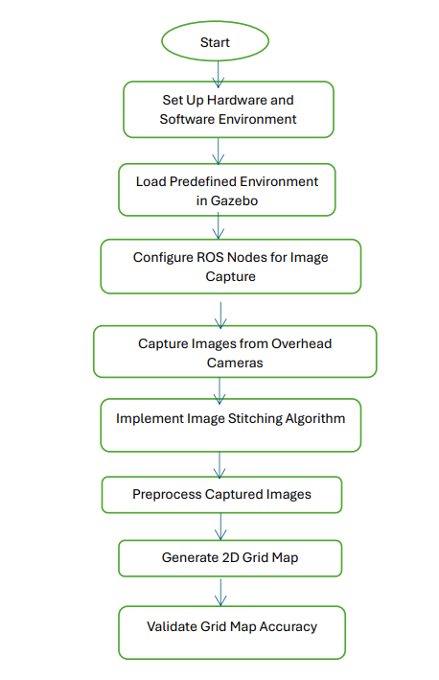
Architecture Diagram
Work flow of the project:

Slide 6
Technologies used
Simulation Tools:
Gazebo simulation environment.
ROS2 for robotics simulation and control.
Hardware:
RGB cameras arranged in a 2x2 matrix.
Intel Core i5 (10th Gen) for processing.
Software:
ROS2 Foxy for integration and control.
Image processing and SLAM algorithms.

Slide 7
Team members and contribution:
Task and Responsibility | Team Members
Analysis of the problem statement | M.Rama krishna P. Mary Ann
Solution Design and Solution Approach | P. Mary Ann R. Anusha
Implementation of the solution | P. Mary Ann M. Rama krishna
Documentation of the solution | M. Rama krishna R. Anusha

Slide 8
Conclusion
Utilizing a network of RGB cameras in a 2x2 matrix, our project aims to revolutionize AMR navigation by enabling real-time, comprehensive environment mapping without costly LiDAR or depth cameras.
By leveraging multi-camera fusion techniques and depth estimation algorithms, we achieve high-accuracy 2D occupancy grid maps that facilitate precise path planning and obstacle avoidance.
Our solution not only reduces deployment costs but also enhances AMR operational efficiency by providing non-line-of-sight capabilities and robust multi-robot coordination for complex environments.
We rigorously evaluate our approach based on map accuracy (<10% error), computational efficiency (<1000ms latency), and practicality, ensuring it meets industry standards and surpasses conventional SLAM methods.
Moving forward, our project sets the stage for scalable, adaptable AMR systems capable of seamlessly integrating with existing infrastructures, paving the way for safer and more efficient robotic operations in diverse settings.

